Slide 1
Installing Rstudio on AWS

Slide 2
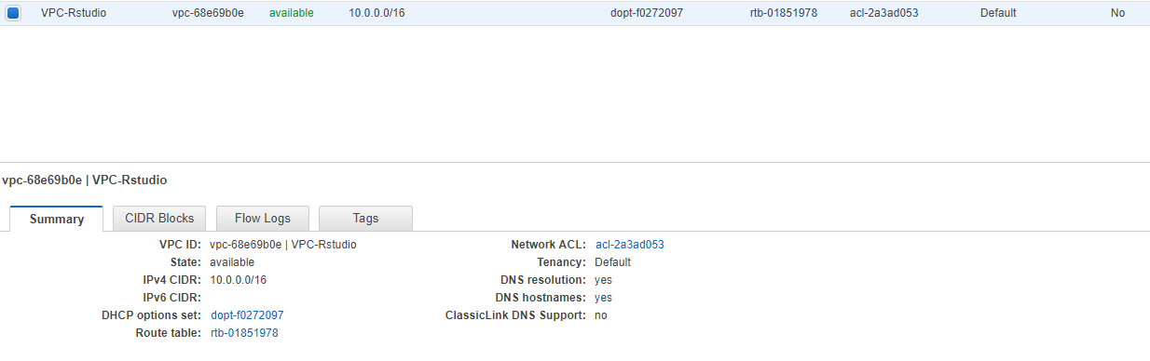
Create VPC

Slide 3
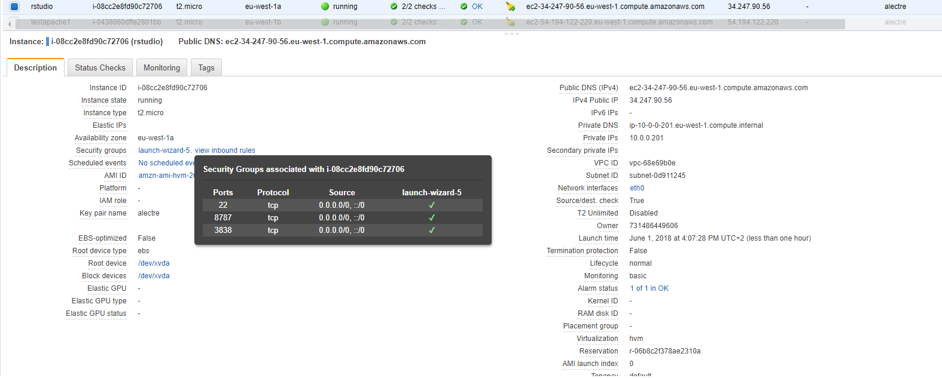
Launch instance 1/3

Slide 4
Launch instance 2/3
When creating instance, copy/paste the following user data to install Rstudio and setup the username and password to access it.
#!/bin/bash
#install R
yum install -y R
#install RStudio-Server 1.0.153 (2017-07-20)
wget https://download2.rstudio.org/rstudio-server-rhel-1.0.153-x86_64.rpm
yum install -y --nogpgcheck rstudio-server-rhel-1.0.153-x86_64.rpm
rm rstudio-server-rhel-1.0.153-x86_64.rpm
#install shiny and shiny-server (2017-08-25)
R -e "install.packages('shiny', repos='http://cran.rstudio.com/')"
wget https://download3.rstudio.org/centos5.9/x86_64/shiny-server-1.5.4.869-rh5-x86_64.rpm
yum install -y --nogpgcheck shiny-server-1.5.4.869-rh5-x86_64.rpm
rm shiny-server-1.5.4.869-rh5-x86_64.rpm
#add user(s)
useradd alectre
echo alectre:dsti | sudo chpasswd

Slide 5
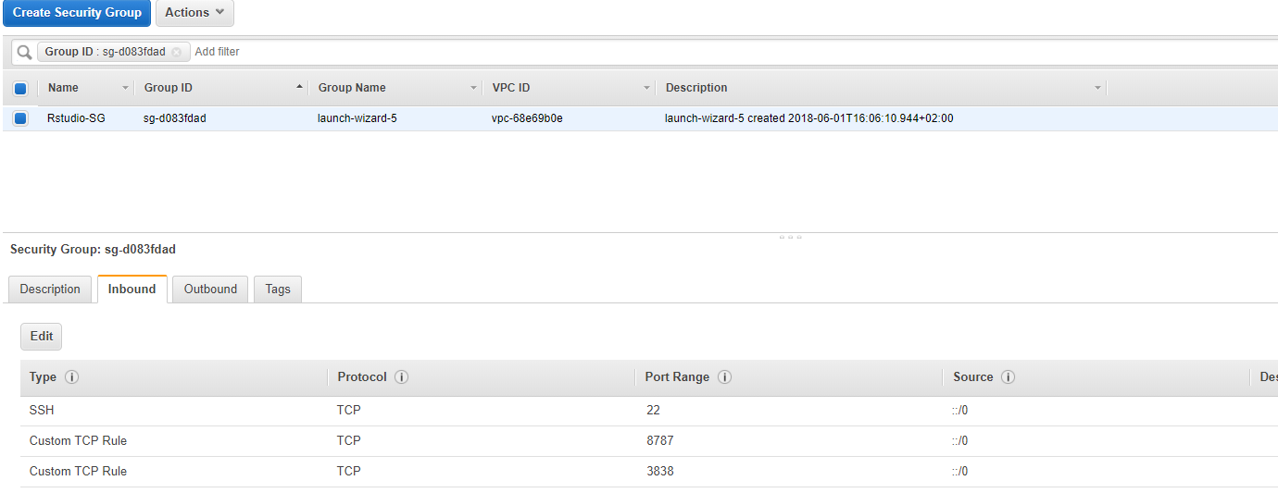
Launch instance 3/3
Configure the security group to open port 8787 so that we can access Rstudio

Slide 6
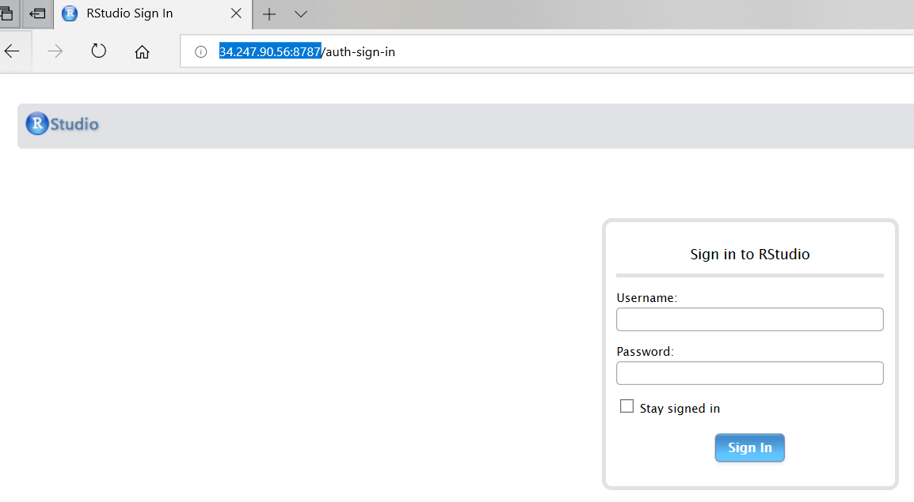
Accessing Rstudio

Slide 7
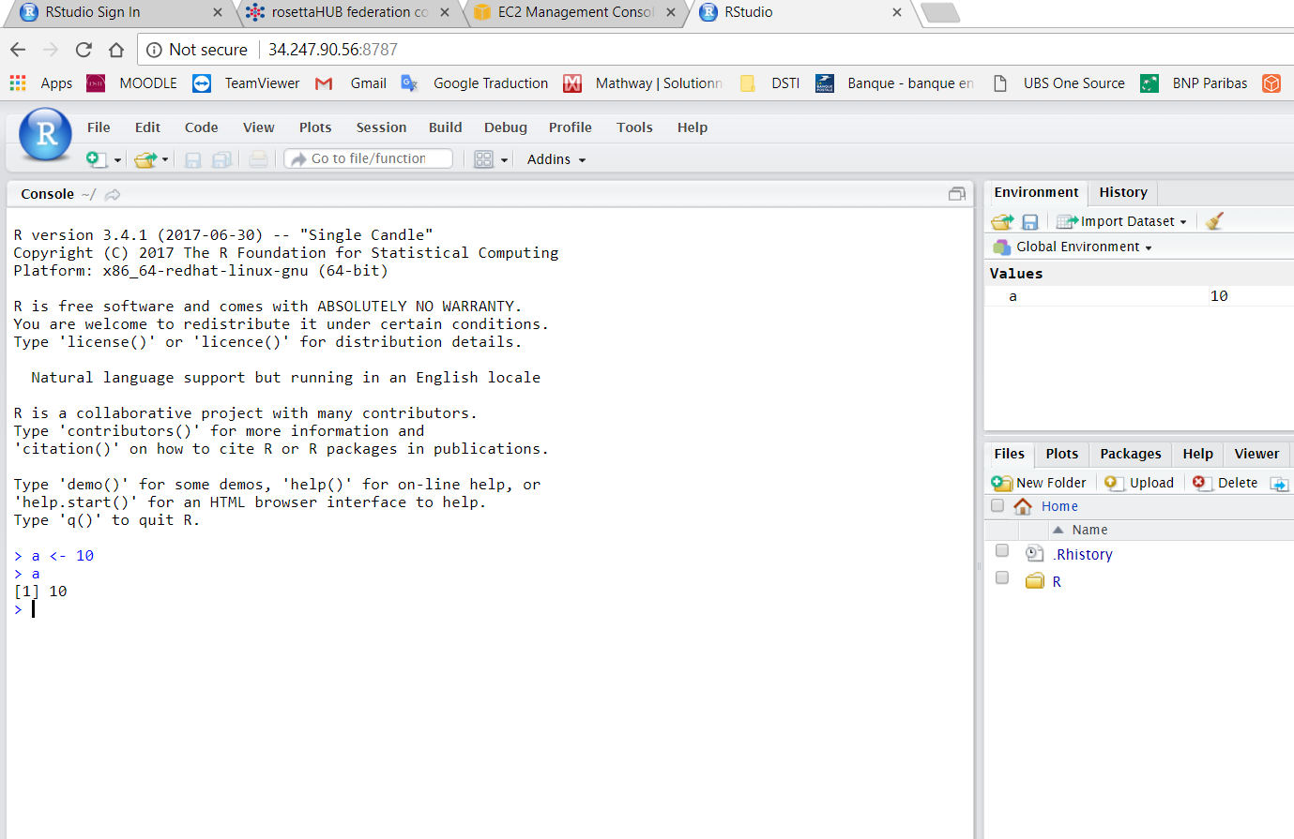
Playing with Rstudio

